Slide 1
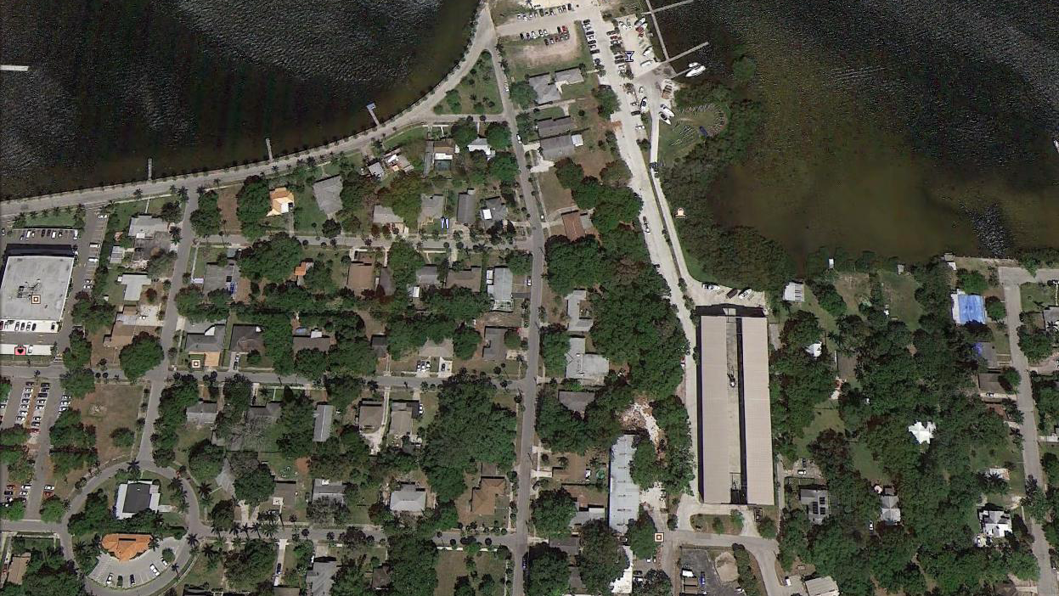
Tarpon Pointe Project
Development Opportunities due diligence investigation

Slide 2
Executive summary
Flatlander Equity Partners, L.P. has requested due diligence investigation of the proposed marina and condominium development, Tarpon Pointe. There are 3 development opportunities on the 7 waterfront acres on the Manatee River-
  Private marina with large yacht slips for boats up to 100’
  High-end condominiums/townhomes
  High-and-dry boat storage facility
After a careful review of the documents and findings from the seller’s due diligence, the project as stated is NOT feasible and Flatlander Equity Partners, L.P. should terminate the contract to eliminate any further losses.

Slide 3
environmental

Slide 4
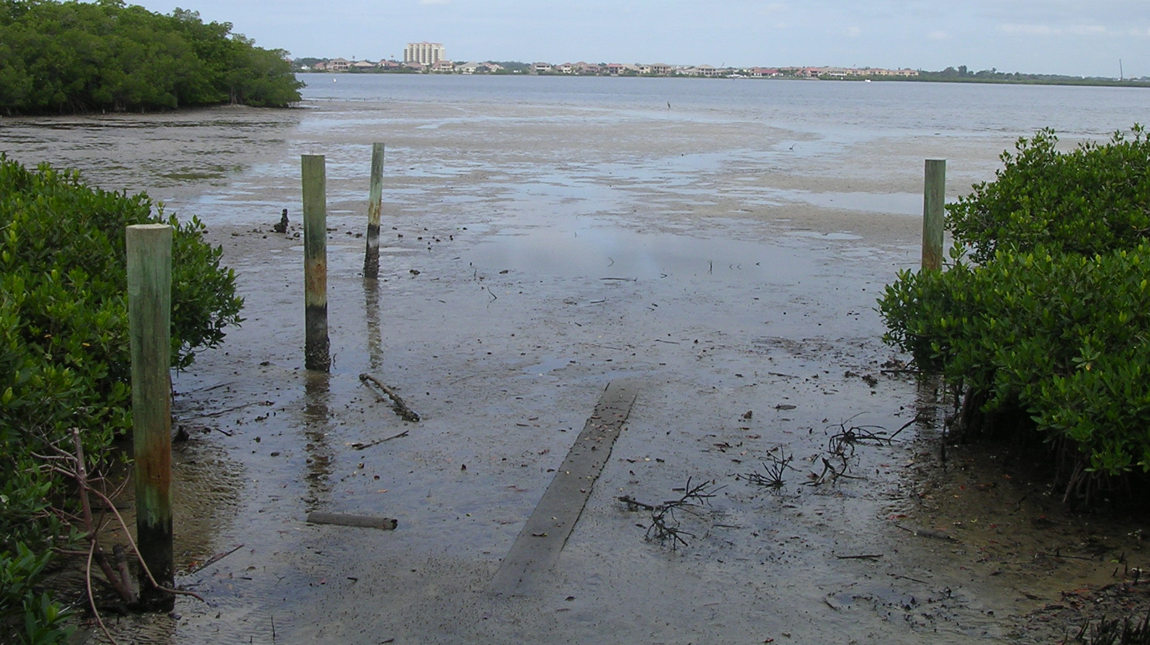
Environmental
The Tarpon Pointe project has an assortment of environmental issues that could cause a delay to the start of this project or even cause the project to fail. The site was assessed by the National Marine Fisheries Service (NMDF) and determined there are seagrass/submerged aquatic vegetation (SAV), mangroves, and potentially federally listed threatened species. Based on their findings, the NMFS does not support the issuances of permits and recommended the new planned load-out ramp be scratched along with 2 other docks due to mangrove clearing. A formal review of the Endangered Species Act would be required and could take as long as 18+ months to complete.

Slide 5
Environmental
Furthermore, a Phase I ESA has not been completed. Considering previous uses of this site, there is an increased likelihood there is contamination of fuel, or solvents. There could potentially be very costly remediation measures that would need to be taken. This also prevents the CERCLA liability defense to protect the project and the purchaser can inherit environmental cleanup costs. The environmental impact of this project is quite significant, and it remains unknown if permitting would ensue despite the capital expense of this due diligence.

Slide 6
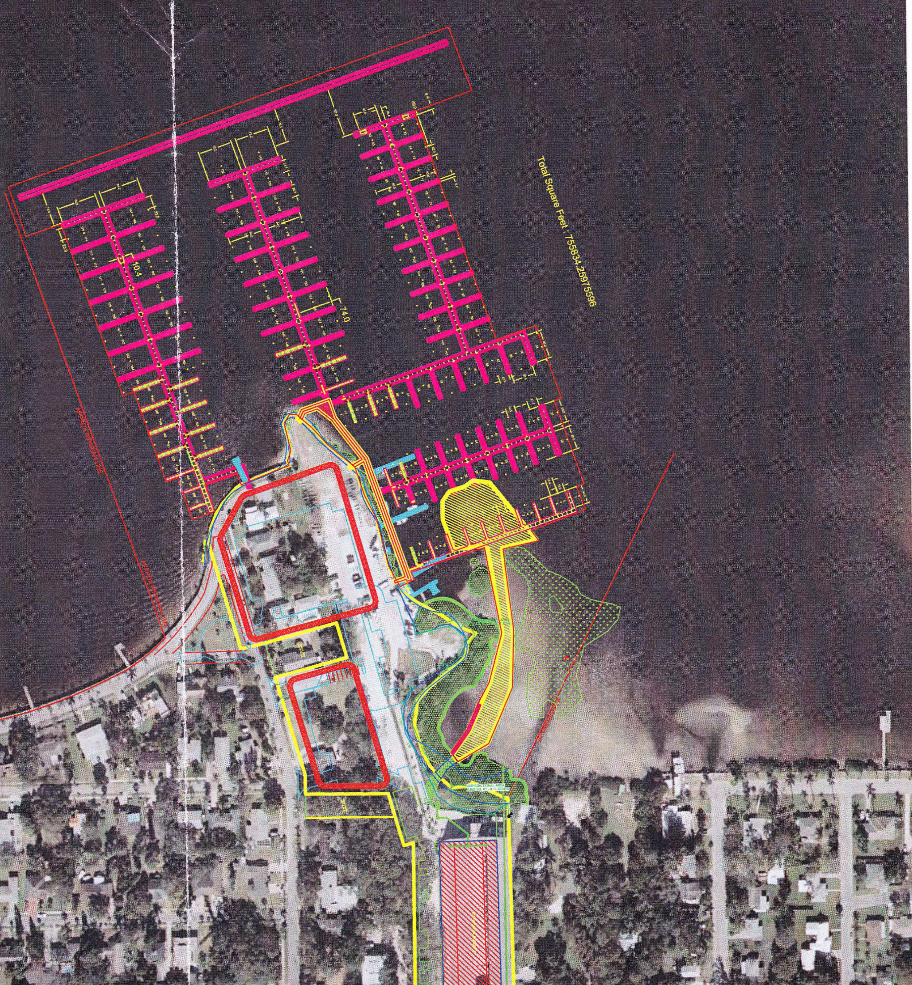
Environmental
The Department of Environmental Protection (DEP) also concluded that the dredge exemption application was incomplete, thus subject to a new dredge permitting process further delaying the project. A submerged land easement will also be required which could be objected to by surrounding owners thus preventing the private marina. Private slips cannot be constructed over state owned submerged land unless the easement is granted.

Slide 7
Legal & regulatory

Slide 8
Legal & regulatory
The Tarpon Pointe project has several significant regulatory barriers from local to federal jurisdictions. As mentioned above, the NMFS had an unfavorable evaluation which will likely cause the U.S. Army Corps of Engineers to not grant permits. While the city has previously granted the PDP approval, state and federal agencies override this authority. The previous PDP that was approved is vastly different than the project being presented today.

Slide 9
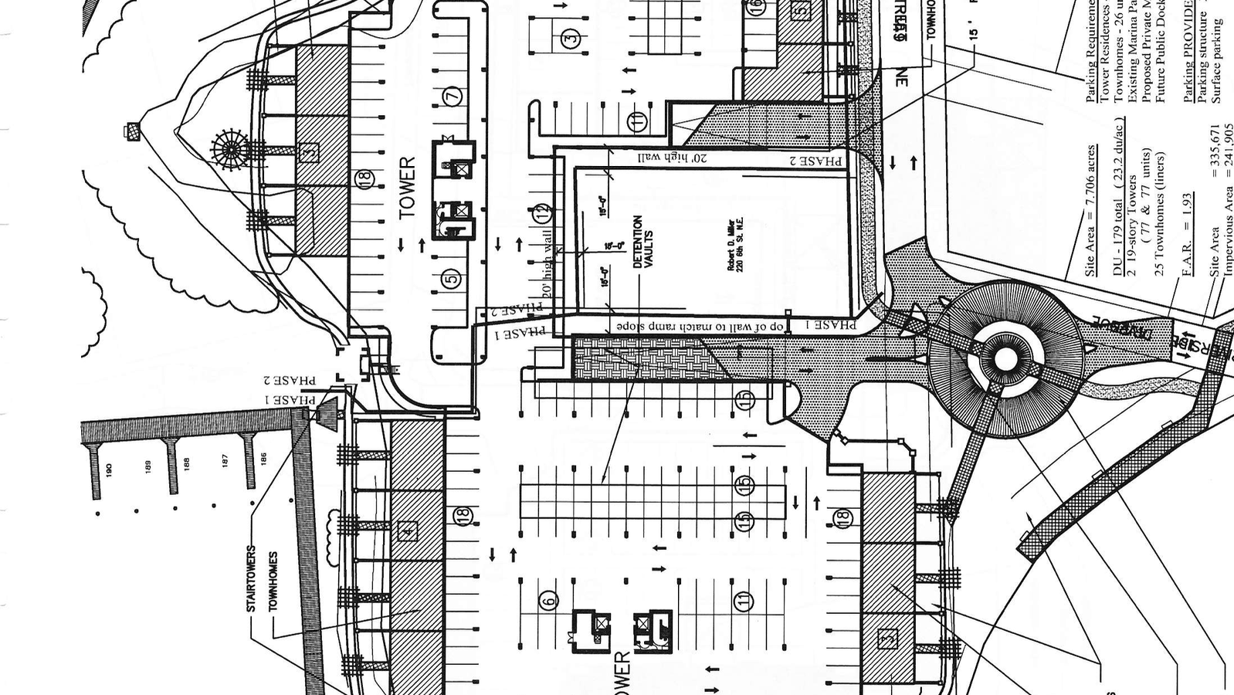
Legal & regulatory
In 2006, a Traffic Impact Analysis (TIA) was conducted and showed negative results regarding the project. Roads would not be able to be widened due to ROW restrictions, no space for sidewalks, and intersection LOS failures. A new TIA will need to be conducted considering new weekend marine traffic, boat maneuvering, and peak-season increase in population. Required traffic improvements could cost millions and delay construction threatening the timelines. Without further due-diligence, costs will add up with unknown results and still leave this project with the potential for complete permit denial.

Slide 10
physical

Slide 11
Physical
The physical condition of the site bears its own set of obstacles. The only due diligence we have on file is a proposal for borings, yet a geotechnical survey has not been conducted. It is highly probable that there are uncontrolled fill, sands, and discarded materials, unsuitable for shallow foundations. With high rise construction, piles will need to be drilled to depths of 100+ feet with extensive fortification. These costs could well surpass the preliminary budget.

Slide 12
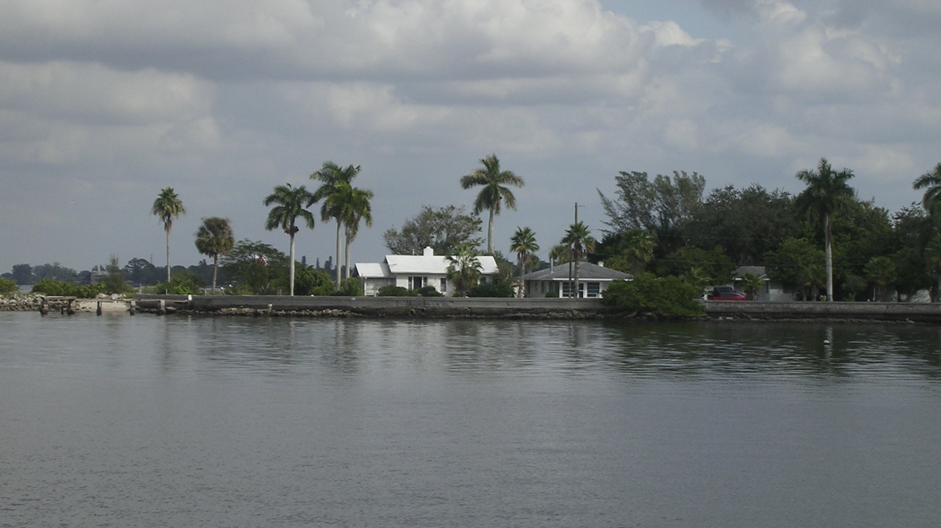
Physical
Since the site is located on the Manatee River, the structures will be susceptible to storms, surges, flooding, and erosion. Each of these factors can financially be a deterrent. Insurance premium spikes and rises in costs of materials makes this project expel more capital to build and maintain. There is also an existing functional high-and-dry facility but is very outdated and would require capital to bring up to current standards.

Slide 13
Location &
Situs

Slide 14
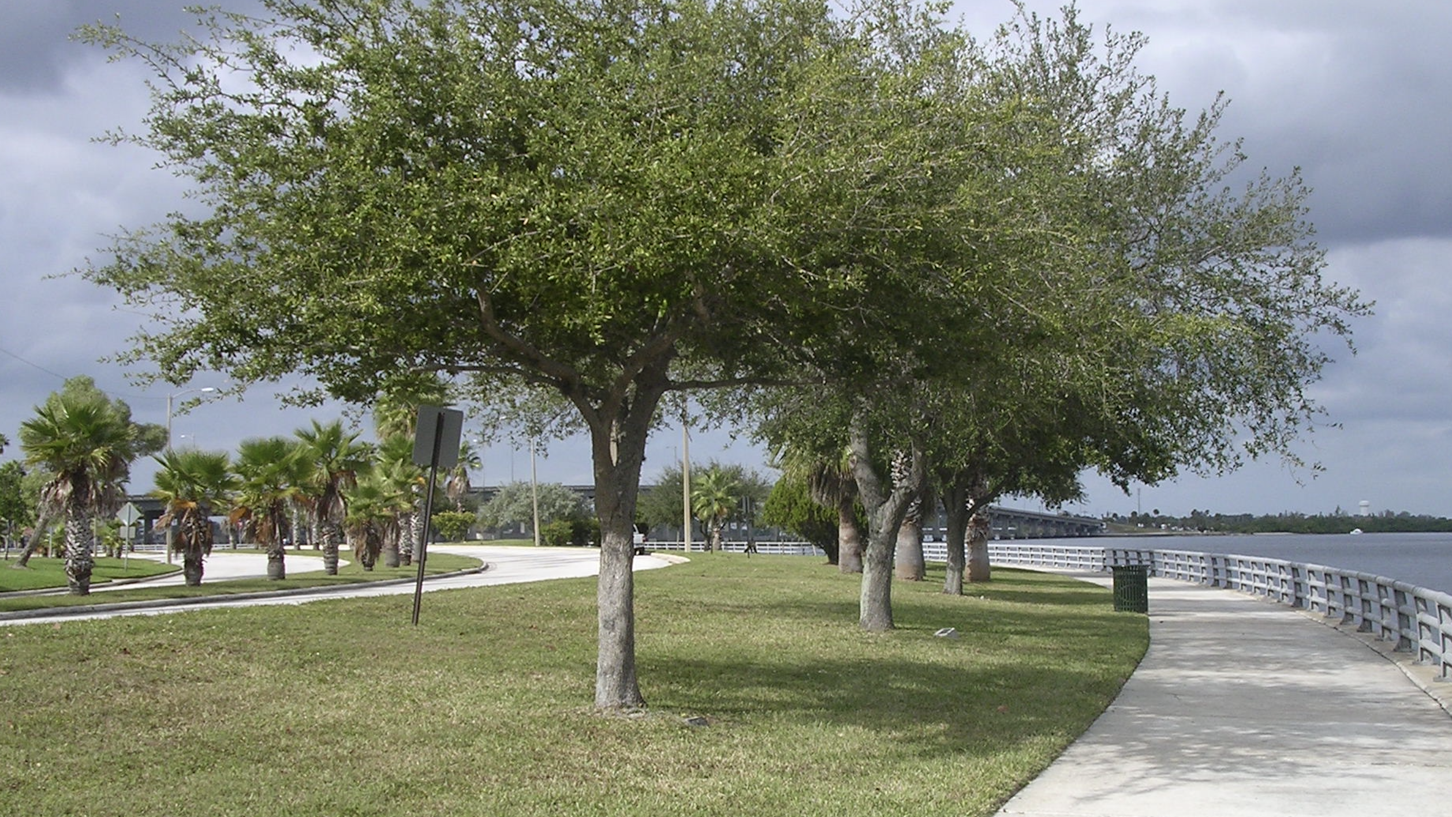
Location & situs
The Tarpon Pointe site is river facing adjacent to downtown Bradenton. With these waterfront views, premium sales prices/rent could be charged assuming the entitlements are approved. The site location also boasts walkability, especially to the downtown areas, and to other recreational sites. However, the site does not have the proper depth for the boat slips, surrounding industrial environments are visually unappealing, and the height and density of the towers are subject to regulation limitations.

Slide 15
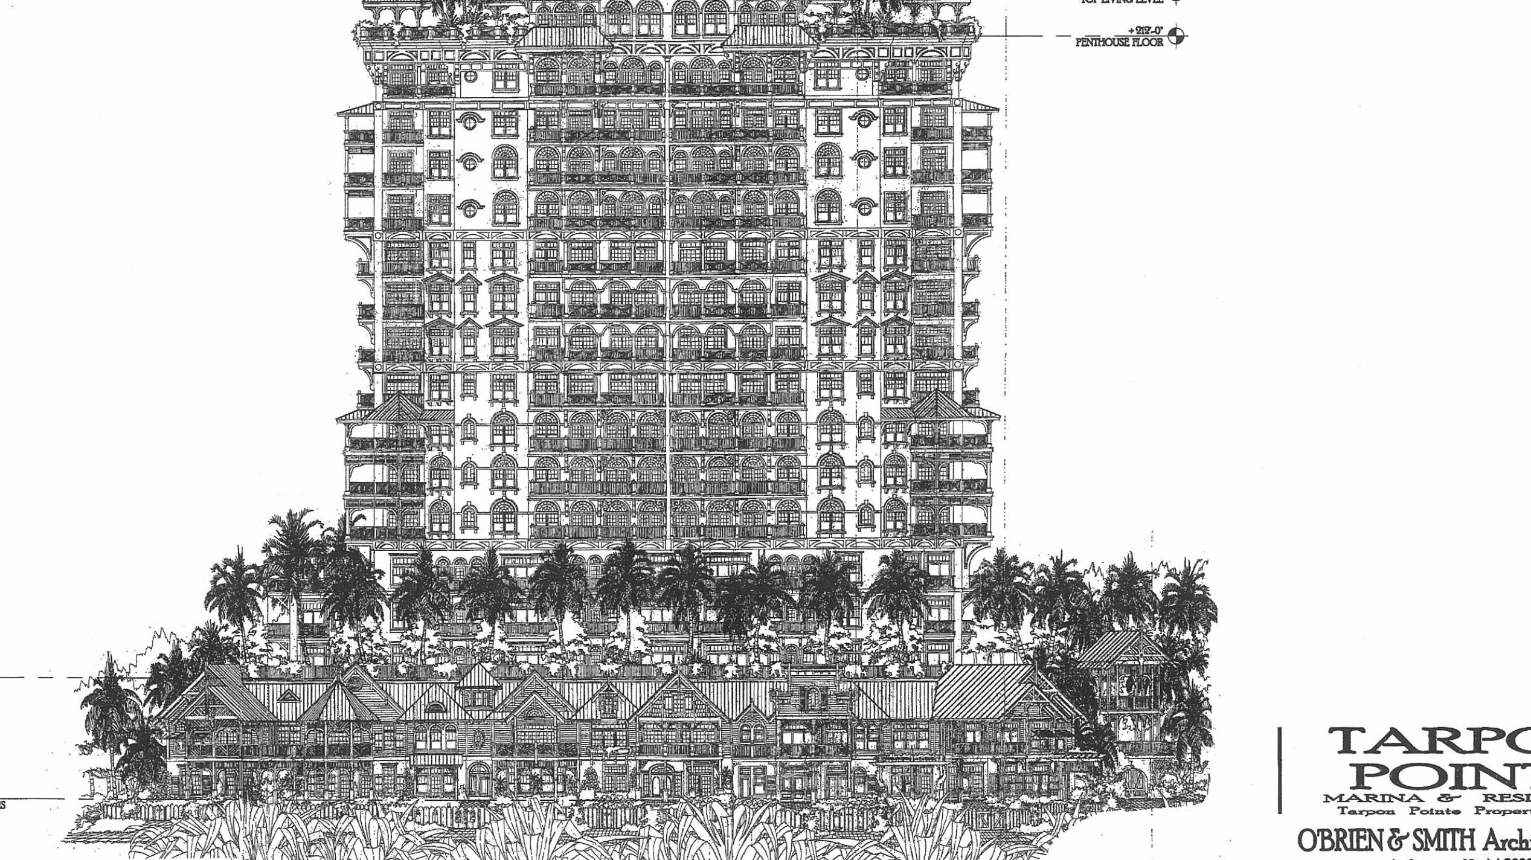
Conclusion with recommendations
Based on feasibility and profitability, the development of high-end residential condominiums has a more predictable path for success and entitlements would more likely be approved versus the other 2 development opportunities. This would be a very high risk, but potentially high reward development.

Slide 16
Conclusion with recommendations
However, it is my recommendation that the developer back out of the contract because it structurally puts all the risks onto the purchaser. $300,000 is due within 30 days with $3,000,000 on the line even if the permits and approvals get denied. There are too many legal, regulatory, and environmental obstacles to overcome within such a short time to risk such a large amount of capital. There is enough documentation provided to substantiate this decision. There is a high risk not having Phase I or II ESA done to identify other potential roadblocks that are more than likely to exist.

Slide 17
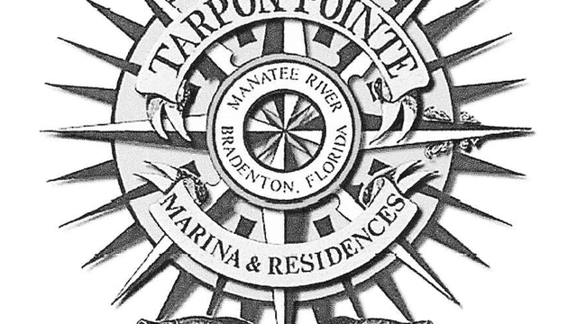
Conclusion with recommendations
While it is still possible to move forward with the development of the condominiums, I would recommend restructuring a new offer that balances the risk for seller and purchaser, allowing a longer feasibility term, and lower sales price based on building and development costs, and most importantly, a contingency on obtaining major entitlements.

