Slide 1
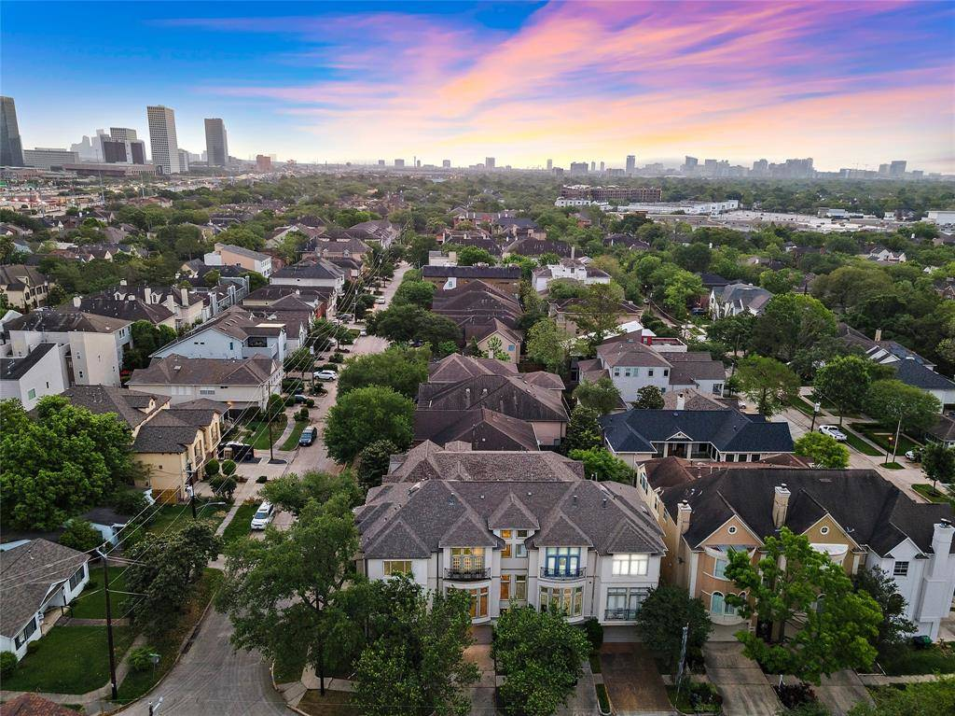
Supply/Demand Exercise- West University Place, TX
Josiah Ford
Rachel Kersten
Tess Dula
Assignment 3

Slide 2
Supply
Part 1
Tess Dula

Slide 3







West University Place Demographics
Population of 14,955
Employment Rate of 57.5%
5,372 Housing Units
5,218 Households
$250,000 Median Household Income
92.6% Homeownership Rate
90.5% Hold Bachelors Degree

Slide 4
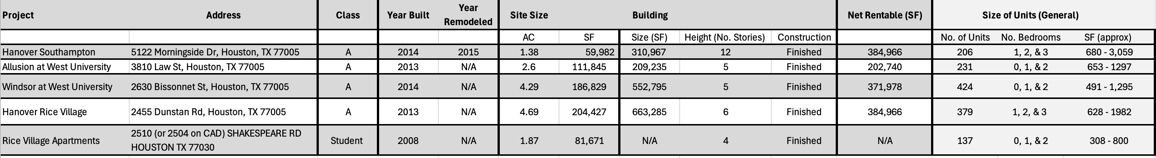
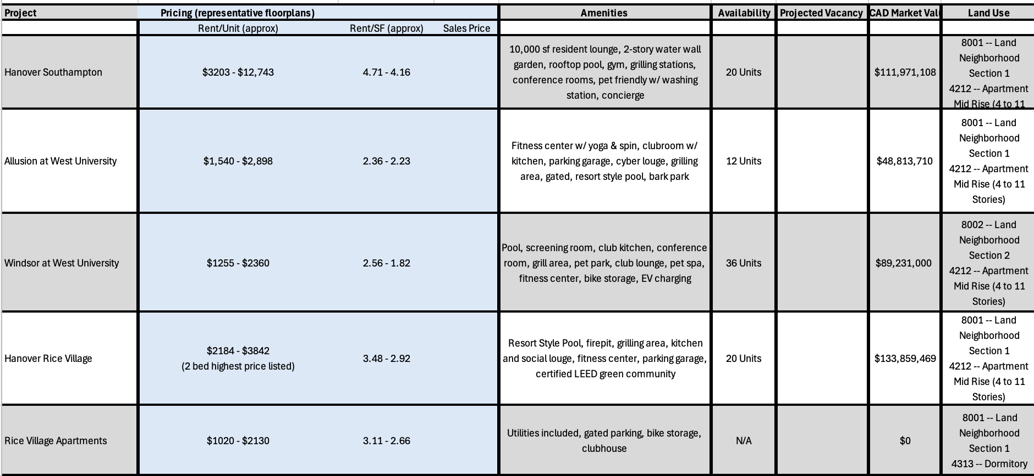
Apartment Matrix

Slide 5
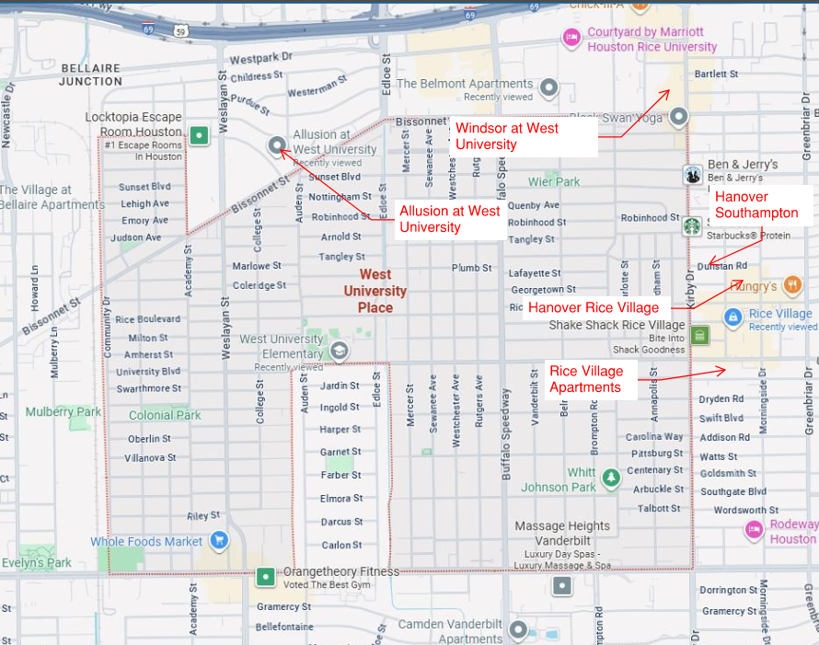
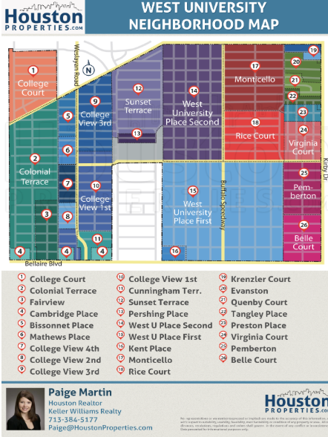
Apartment & Neighborhood Maps

Slide 6
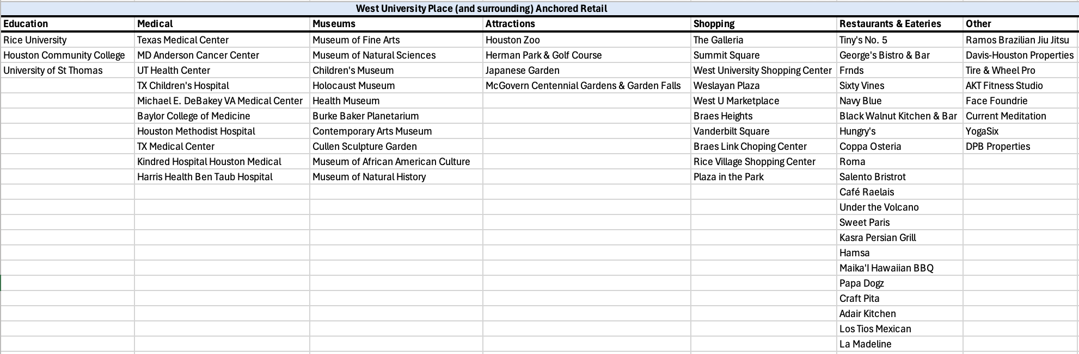
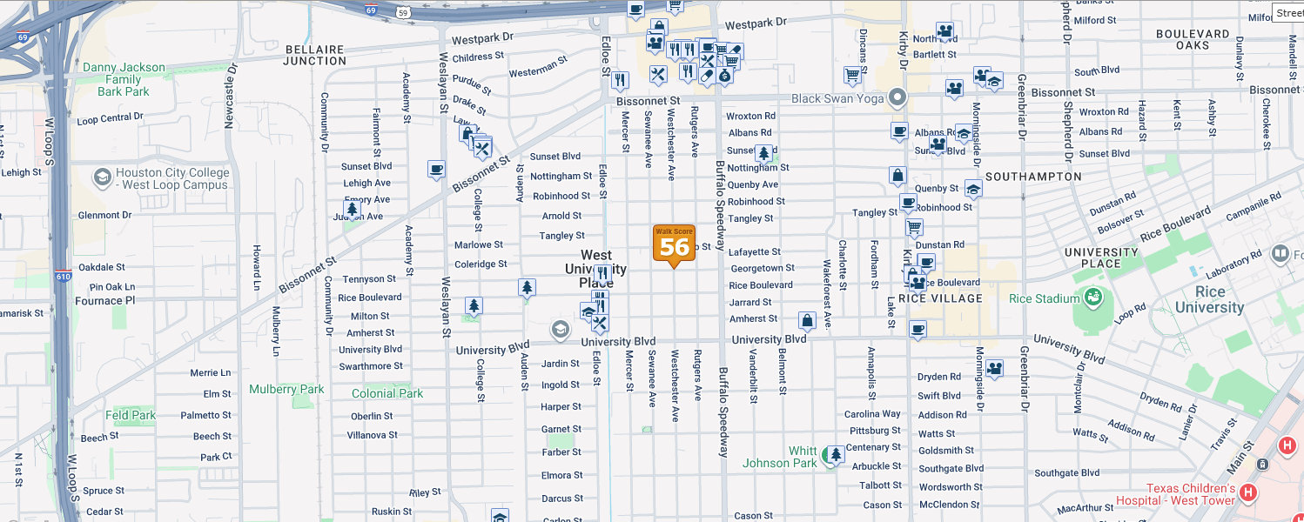
Retail Matrix

Slide 7
Demand
Part 2
Josiah Ford

Slide 8
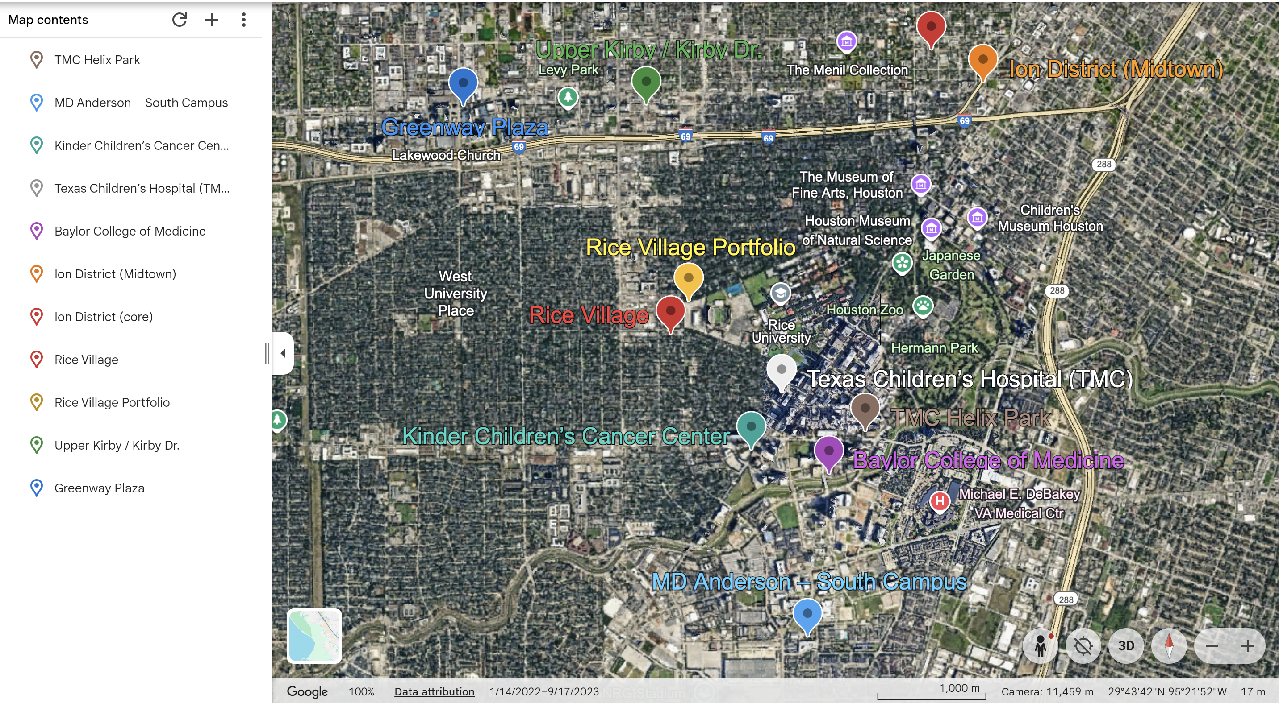
Proposed Commercial Projects

Slide 9
Proposed Commercial Projects
Location | Project | Target Dates (public)
TMC Helix Park | Helix Park (incl. Dynamic One) | 2023–2028+ (staged)
MD Anderson – South Campus | South Campus Research Building 5 | Target ~Spring 2026
Kinder Children’s Cancer Center | Joint MD Anderson + Texas Children’s facility | Target early 2026 (opening)
Texas Children’s Hospital (TMC) | Pediatric Tower expansion | 2024–2027 (phased)
Baylor College of Medicine | Lillie & Roy Cullen Tower (Health Sciences Park) | Education move-ins starting 2026
Ion District (Midtown) | The Arc (new wet lab/R&D/office) | Announced 2025; deliver TBD (multi-year)
Ion District (core) | Ion + ongoing campus infill | 2021–ongoing
Rice Village | 2-acre redevelopment site (mixed-use potential) | 2025–2028 (speculative)
Rice Village Portfolio | Streetscape & public-space upgrades | Multi-year
Upper Kirby / Kirby Dr. | Office repositioning’s (multiple assets) | 2025–2027 (rolling)
Greenway Plaza | Campus amenity & courtyard revitalizations | 2024–2027

Slide 10
Proposed Jobs Coming (5 Years)
Anchor expansions nearby
TMC Helix Park (life-science district, 37 acres): public materials cite 23k–26.5k permanent jobs at full buildout
5-year realization slice is 20–35% as phases lease-up, 4.6k–9.3k new permanent jobs attributable within five years. Source: wpb.houston.org+3Texas Medical Center+3Texas Medical Center+3
MD Anderson – South Campus Research Building 5 (600k SF): opens spring 2026; incremental research staffing (no official headcount published) → Expect at least 1,000 people due to building size.
Baylor College of Medicine – Lillie & Roy Cullen Tower (503k SF; phase 1 of 800k “Health Sciences Park”): education/research consolidation starting 2026; planning add of low hundreds. Source: Baylor College of Medicine
Ion District – “The Arc” (200k SF wet-lab/R&D/office, Midtown): announced 2025; job count TBD; treat as incremental R&D/tech roles as it leases. Expect 200+ jobs as a estimate. Source: Ion District
Trade-area 5-year estimate
Combining a partial Helix Park realization with conservative MD Anderson/BCM/Ion ramps yields a five-year net new jobs range ≈ 5,000 (low) to 12,000–13,000 (high), with a base case ~7,500–9,000. This keeps the node-level math consistent with broader Houston metro trends (1–2%/yr bands in recent Partnership/Dallas Fed updates). wpb.houston.org+1

Slide 11
Income Ranges to Use (by likely occupations)
Use Bureau of Labor Statistics (latest OEWS/OOH) as defensible brackets; Houston MSA means/medians are shown where available:
Healthcare practitioners & technical (Houston MSA): mean: $98,070. Bureau of Labor Statistics
Registered-nurse / clinician cohort (proxy): national median $93,080–$93,600 (Houston typically near this). Bureau of Labor Statistics
Clinical lab technologists/techs (US median; TX/Houston similar order): $61,890 ($38k–$98k). Bureau of Labor Statistics
Medical scientists (US median; research roles common in Helix/TMC): $100,590 ( $62k–$168k). Bureau of Labor Statistics
Software developers (Ion/tech tenants proxy, US): $133,080 median ( $80k–$211k). Bureau of Labor Statistics
All-occupation average (Houston MSA context): mean: $31.87/hr (~$66k/yr). Bureau of Labor Statistics

Slide 12
Current Jobs & Household Income Data
Area | Estimated Employed Residents / Job Base* | Key Resident Industries / Occupational Mix | Median Household Income (or published)
West U | 6,280 employed residents | Health Care, Professional / Scientific, Finance & Insurance; occupations: practitioners, management, business ops | $250,001
Medical Center | 8,500 population | Mixed: many support / service staff, staff, etc. | $72,658
Midtown Houston | 4,700+ households | 92.9% white-collar among employed residents | $85,436

Slide 13
Estimated Incoming Household Growth per Annum
Area | Annual Growth Assumption | 2030 Households (proj.)
West University Place | +0.47%/yr | 5,630
TMC / Medical Center Area | +2.30%/yr | 5,240
Rice Village Vicinity | +0.70%/yr | 2,702
Midtown Houston | +1.10%/yr | 5,246

Slide 14
5 Year MF Demand Projection (Units Needed)
Total for the trade area: TMC South/Hermann Park, Rice Village edges, Upper Kirby/Greenway, Midtown/Ion.
Year | Units
2026 | 450
2027 | 575
2028 | 625
2029 | 600
2030 | 575
5-yr total | 2,825

Slide 15
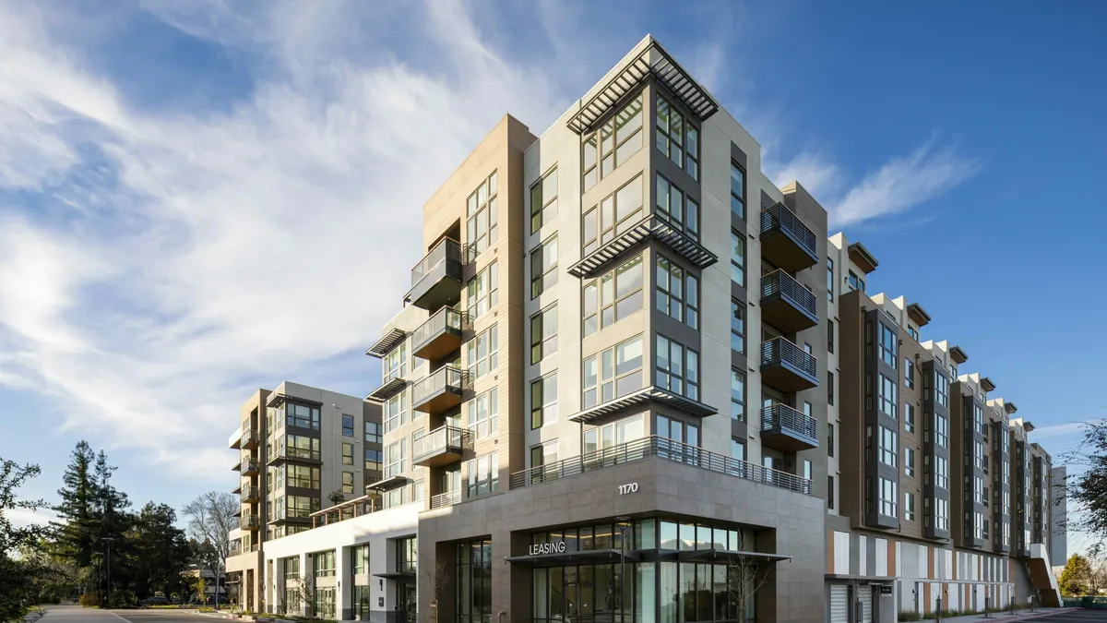
Project Concept
Class A, mid-rise, 5 story building
Approximately 60 units
Units range from 1,800-2,000 sq. ft
2-3 bedrooms
Rent starting at $3,250
Amenities include-
Rooftop pool
Valet parking
Community spaces
Office
Dry cleaning services
Pet concierge

